Slide 1
My journey to a PhD
Akiko Sato
13 February 2019 at BHASVIC

Slide 2
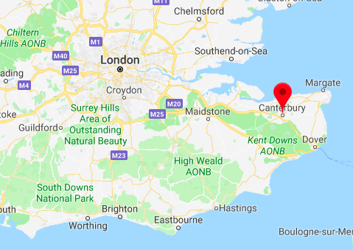
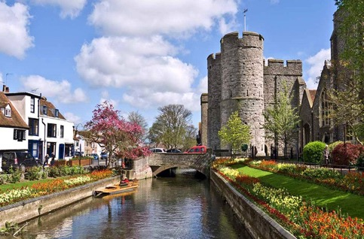
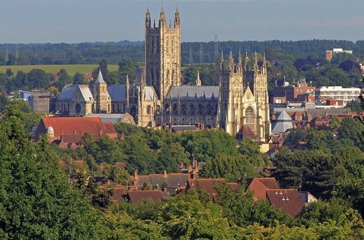
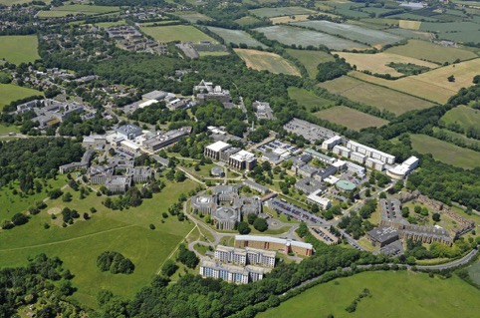
My current position: a PhD student at the university of Kent (Canterbury)
University of Kent

Slide 3
Outline
Introduction & background
Undergraduate research
・Supramolecular chemistry
Science outside the laboratory
・Career options in/outside lab
Current work
・The life of a PhD student
・DNA-Peptide conjugation
Q&A

Slide 4
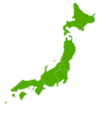
A brief background of myself
My origin: Japan
Studied in Japan and the UK
Worked in Greece
2008
2011
2015
2017
Sixth Form
at Hove Park
Kyoto Prefectural
University,
BSc in Biomolecular Chemistry
University of Kent,
MSc in Science
Communication
University of Kent,
PhD in Chemistry
Biology
Chemistry
Work experience
in Greece
Mathematics

Slide 5
Undergraduate – Biomolecular Chemistry
Year 1-3 modules
Final year
(Thesis)
Organic Chemistry
Physical Chemistry
Laboratory
work
Analytical Chemistry
Polymer Science
Microbial Physiology
Cellular Biochemistry
+
Own research
project
Enzymology
Macromolecule Science, etc.
Laboratory practice
I felt very uncomfortable due to lack of confidence...
My hands were shaking when trying to hold glassware…
Even if you are too nervous about working in the lab or you think
you are not good at it, don’t give up because you’ll overcome this.
But, I overcame the fear of working in the lab in the final year ☺

Slide 6
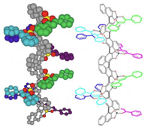
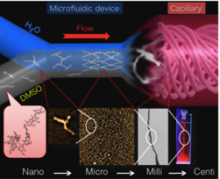
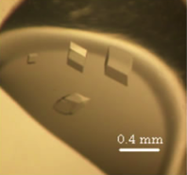
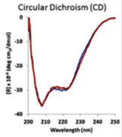
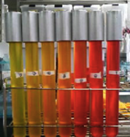
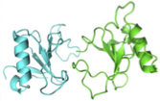
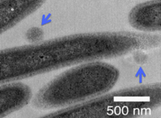
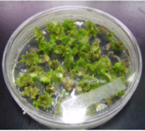
Choosing a research group for my undergrad
Synthetic Chemistry of Functional Molecules
Molecular Nanosystems
Biostructural Chemistry
Biophysical Chemistry
Bioanalytical Chemistry
Applied Microbiology
Molecular and Cellular Biochemistry
Supramolecular Chemistry

Slide 7
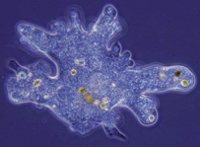
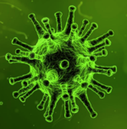
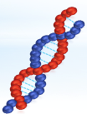
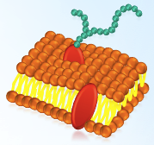
Why was I interested in Biomolecular Chemisty?
I wanted to explore questions:
“What is the difference between living things and non-living matter?”
vs
“How can simple molecules form complex structures?”
c
c
c
c

Slide 8
Why cannot we create living systems from single molecules ?
Unstable
The second law of thermodynamics
Energy
Ordered structure
Energy
Thermodynamic structure
Stable
Disordered structure
Time

Slide 9
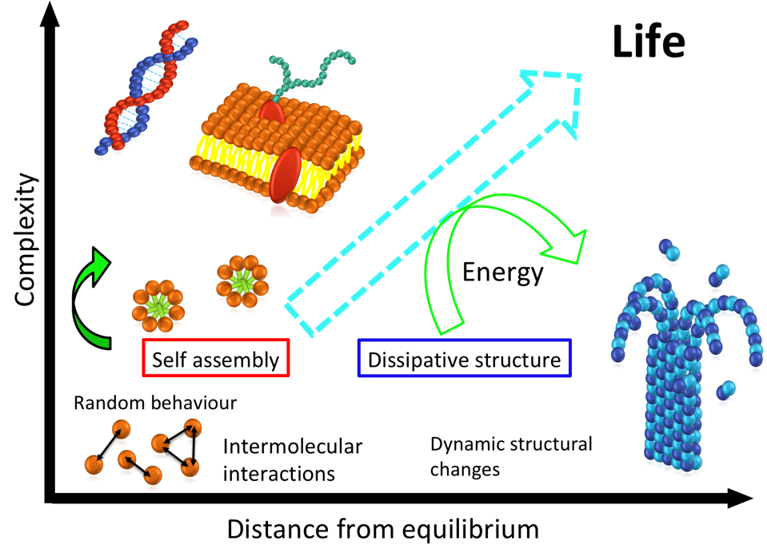

Slide 10
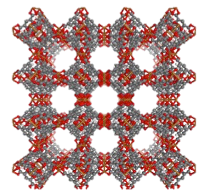
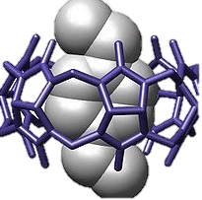
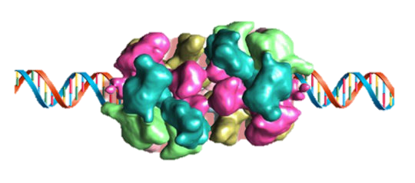
Supramolecular chemistry
“Chemistry beyond the molecule”
Molecular networks
Molecular capsules
Molecular machines
Inclusion of small molecules
Drug delivery
Supporting life

Slide 11
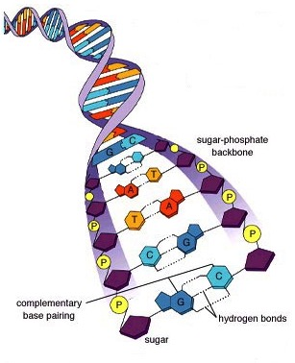
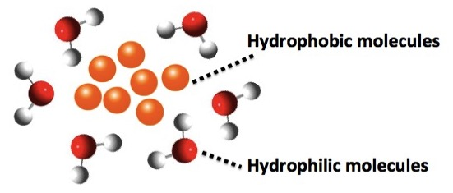
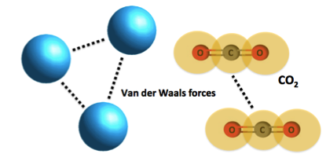
Supramolecular chemists are interested in intermolecular forces.
Hydrogen bonds
Van der Waals forces
Interactions
Interactions
Notes:
Organic chemistry, nanotechnology, DNA, chloroplast
Images of intermolecular forces

Slide 12
What do we aim for?
To control molecular behaviour
To create unprecedented super structures
(next-generation materials)
To understand biological systems better
(biomimetic materials)

Slide 13
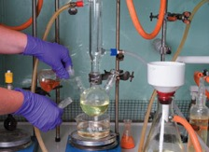
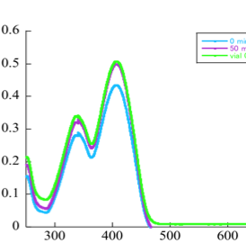
What knowledge and skills are required?
Organic chemistry
To design and synthesise molecules
Physical chemistry
To study the properties of chemical compounds
Biochemistry
To get inspiration from biomolecules
Abs.
Wavelength / nm
Notes:
Visualise
Organic:
Physical: analytical stuff,

Slide 14
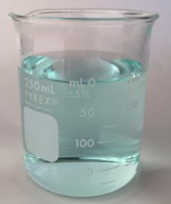
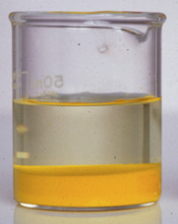
How do we study molecular behaviour?
Dissolve molecules in a solvent: H₂O, MeOH, CDCl₃
In a good solvent
In a poor solvent
Analyse the self-assembled molecules using
spectroscopy, microscope, electrophoresis, etc.

Slide 15
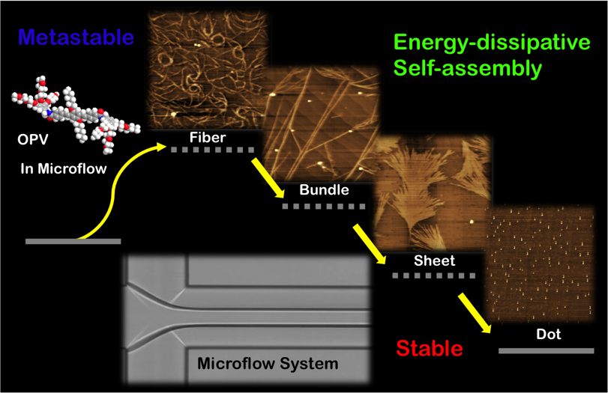
My undergraduate research
Creating supramolecular structures under non-equilibrium
N. Numata, A. Sato and R. Nogami, Chem. Lett. 44, 995-997 (2015).

Slide 16
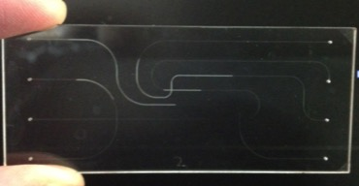
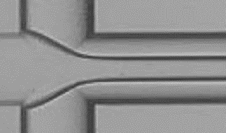
Microfluidic device
Inside diameter
= 100 μm
Laminar flow
Rapid diffusion
Energy supply by “flow”
Providing non-equilibrium conditions

Slide 17
Experimental & Analytical Methods
Laminar flow
Poor solvent
UV-Vis Spectra
Fluorescent Spectra
AFM, IR
Molecules
in good solvent
Poor solvent
Flow sample
Vial sample

Slide 18
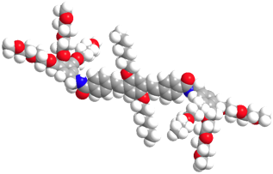
Molecular design :
Amphiphilic OPV molecule
OPV molecule
π-stacking
Hydrophilic
Hydrophobic
Van der Waals force
Hydrogen bonding
OPV : Oligo phenylene vinylene

Slide 19
Synthesis scheme : PartⅠ

Slide 20
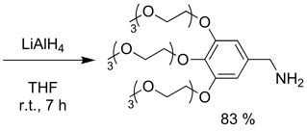
Synthesis scheme : PartⅡ

Slide 21
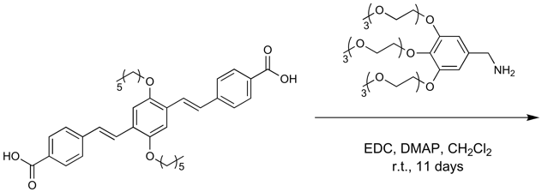
Synthesis scheme : Part Ⅲ
Oligo phenylene vinylene molecule

Slide 22
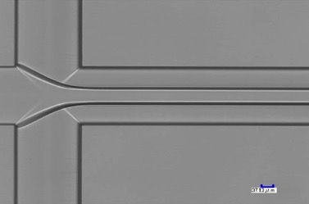
Condition: THF/ H2O
Condition
Final Conc. 0.04 mM
Center flow rate 8 μl / min
Side flow rate 6 μl / min
Final flow rate 20 μl / min
Solvent composition THF : H₂O = 4 : 6
Inside the micro channel
0.1 mM
OPV molecules
in THF
H2O
H2O
Flow sample
Vial sample

Slide 23
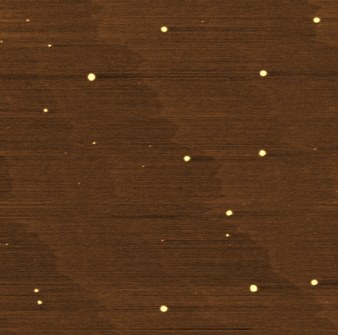
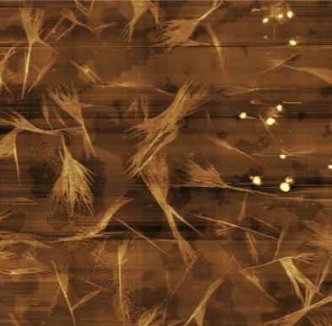
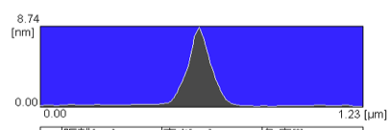
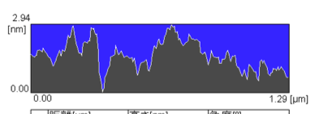
AFM images
~10nm height
spherical structures
2-3 nm thick
fiber structures
Vial
Flow
10 min
5 μm
5 μm
5 μm

Slide 24
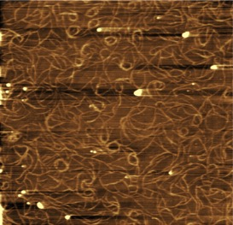
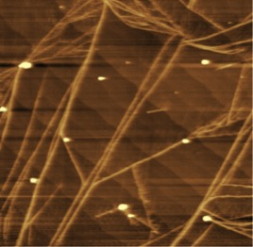
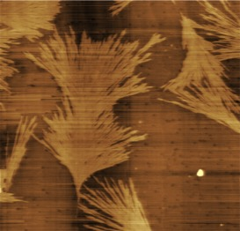
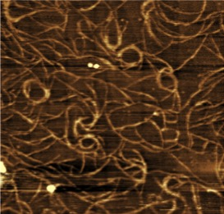
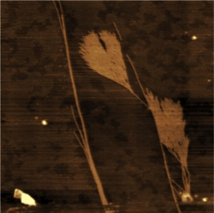
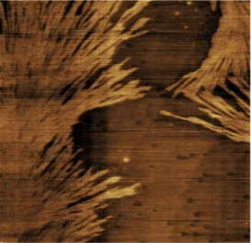
Atomic Force Microscope images: Dynamic structural changes
5 μm
2 μm
0 min
3 min
5 min

Slide 25
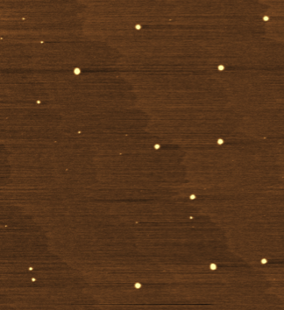
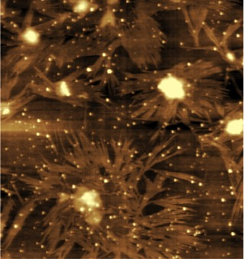
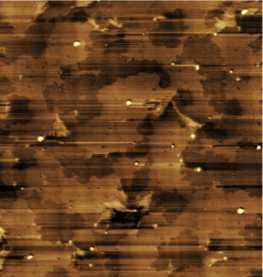
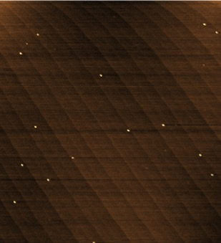
AFM images
Vial
5 μm
10 min
30 min
24 h
Breaking down into small
spherical structures
Fiber structures
completely disappeared

Slide 26
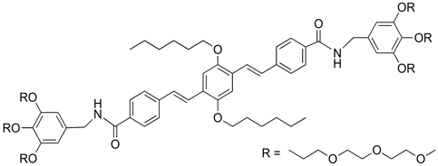
Suggested structural changes
π-π stacking
Fiber forming
Structural
changes
Hydrogen bonding
Metastable
Stable
Assembly
Disassembly
Disassembly
0 min
30 min
24 h

Slide 27
Why I left the lab after my undergraduate?
Wanted to learn science outside of the test tube
To explore a much wider range of scientific topics
beyond the lab
Lab work: often focusing on just one project
Became interested in science communication
Wanted to study abroad

Slide 28
My masters - Science communication at Kent
The public communication of science-related topics to non-experts
In the course…
Learn historical and philosophical contexts of science
Lots of reading & writing essays
Writing a science blog
Presentations in seminars
Dissertation (literature base)
My old course mates

Slide 29
Career options outside the lab
Medical writer
Science writer
Journalism
Teachers
Scientific events organiser
Film-making
Science policy

Slide 30
Lessons learned from the UK uni life
Had a fruitful time with my studies and outside of work
Great contrast with the heavily work-oriented culture in Japan
That’s why I wanted to remain in the UK
Unfortunately, I couldn’t find a job here

Slide 31
So, what happened next?
Sent my CV to a London-based recruitment agency
They told me that a job in Greece would offer me a visa!
Although I ended up doing something unrelated to my studies, I was happy to remain in Europe
Notes:
Visa problem

Slide 32
The life of a PhD (Serpell group)
Similar working hours to a job (9-5)
Weekly meetings with supervisors
Running experiments independently on a daily basis
Giving frequent presentations, posters
Travelling to scientific conferences!
Updating my knowledge with the recent literature

Slide 33
My PhD project
Hierarchical and Emergent Assembly of DNA-Peptide conjugates
Hierarchical assembly
+
Covalent coupling
Emergence
effect
DNA
Peptide

Slide 34
Emergence
Simplicity
New characteristics
or structures
Complexity
“the whole is greater than the sum of the parts”
Intelligence
Emotions
Memory

Slide 35
Orthogonal and hierarchical assembly
Conventional technology
Biological systems
Often one type of building blocks
Multiple components
Limited structural and
Functional diversity
Complex structures with
a new level of sophistication
Our work:
Utilise two different components (DNA and peptides) within a laboratory setting, to create novel emergent superstructures.

Slide 36
Peptide sequences used for conjugation
Peptide sequence Resultant structure
KLVFFA Antiparallel β-sheet
HYFNIF Parallel β-sheet
RVFNIM Parallel β-sheet
6POG Parallel triple helix
GSGC Flexible peptide spacer
Peptide GSGC – DNA
A: Alanine
C: Cysteine
F: Phenylalanine
G: Glycine
H: Histidine
I : Isoleucine
K: Lysine
L: Leucine
M: Methionine
N: Asparagine
P: Proline
R: Arginine
S: Serine
V: Valine
Y: Tyrosine
O:Hydroxyproline

Slide 37
Synthetic Scheme of N-terminus acetylated peptide (Ac-AA-OH)
Ac₂O, DIPEA
2 equiv. EDC
2 equiv. HOBt
0.1 equiv. DMAP
DMF
DMF
Capping
unreacted sites
Resin
20 % Piperidine
Repeat Fmoc deprotection
and amino acid coupling
DMF
2 equiv. TBTU
2 equiv. HOBt
2 equiv. DIPEA
DMF
Fmoc deprotection
20 % Piperidine
Ac₂O, DIPEA
TFA, TIPS, H₂O
DMF
DMF
N-terminus
acetylation
Cleavage from
resin

Slide 38
KLVFFA
HYFNIF
RVFNIF
(POG)₆

Slide 39
Future work
Finding optimal conditions for the conjugation reaction
Studying multiple DNA-peptide conjugations to see
whether they lead to hierarchical or emergent phenomena
Hierarchical assembly
+
Covalent coupling
Emergence
effect
DNA
Peptide

Slide 40
Thank you for listening!

